Slide 1

Pred. Maintenance

Slide 2
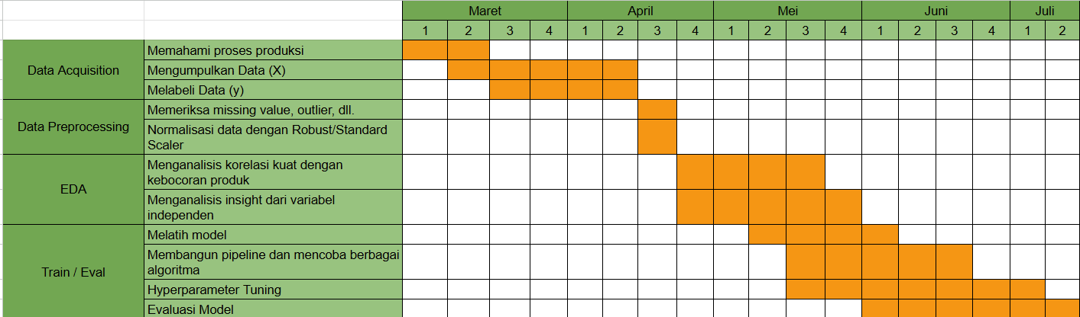
TIMELINE

Slide 3
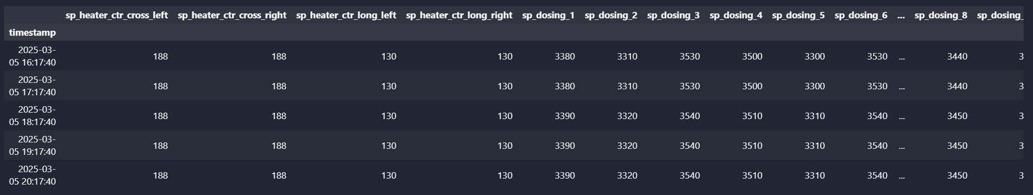
THE LIMITATION IS THAT THE DATA IS NOT VARIED ENOUGH TO DETECT LEAKS
DATA
SET POINT HEATER & DOSING
ACTUAL DOSING
LINE 1-8

Slide 4
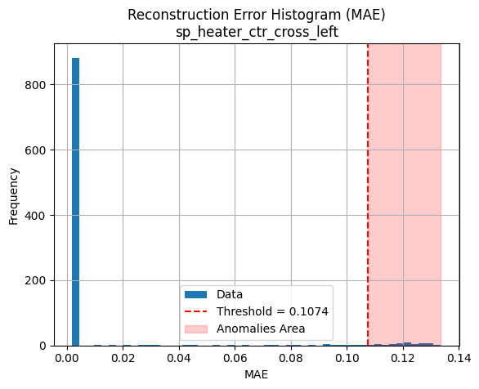
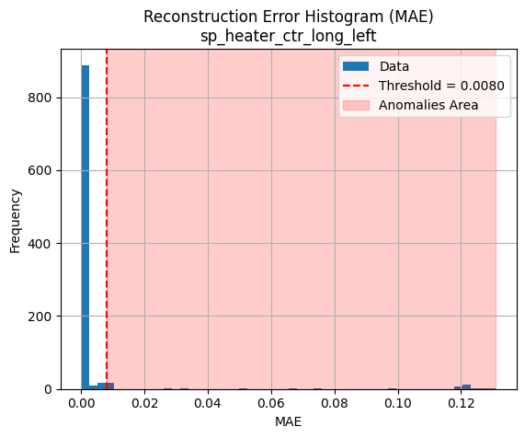
SEBAGIAN KECIL DATA MASUK KE DALAM WILAYAH ANOMALI, MENUNJUKKAN BAHWA FITUR INI CUKUP STABIL DAN HANYA SEDIKIT MENUNJUKKAN PERILAKU MENYIMPANG DARI POLA NORMAL.
MODEL MENDETEKSI BAHWA BANYAK TITIK DATA BERADA DI LUAR POLA NORMAL YANG DIPELAJARI. INI DAPAT MENUNJUKKAN:
ADANYA ANOMALI SISTEMATIS,
OVERFITTING PADA DATA TRAINING (JIKA MODEL TERLALU KETAT),
ATAU ADANYA PERGESERAN DISTRIBUSI DATA (CONCEPT DRIFT).

Slide 5
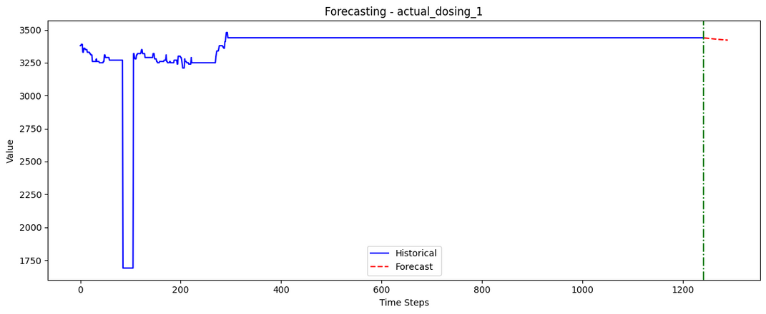
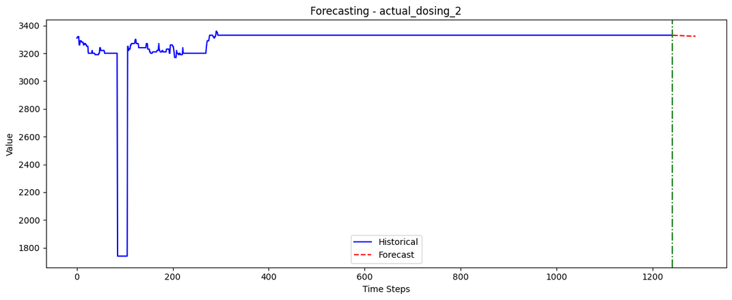
FORECASTING FOR EACH COLUMN

Slide 6

BEJO

Slide 7
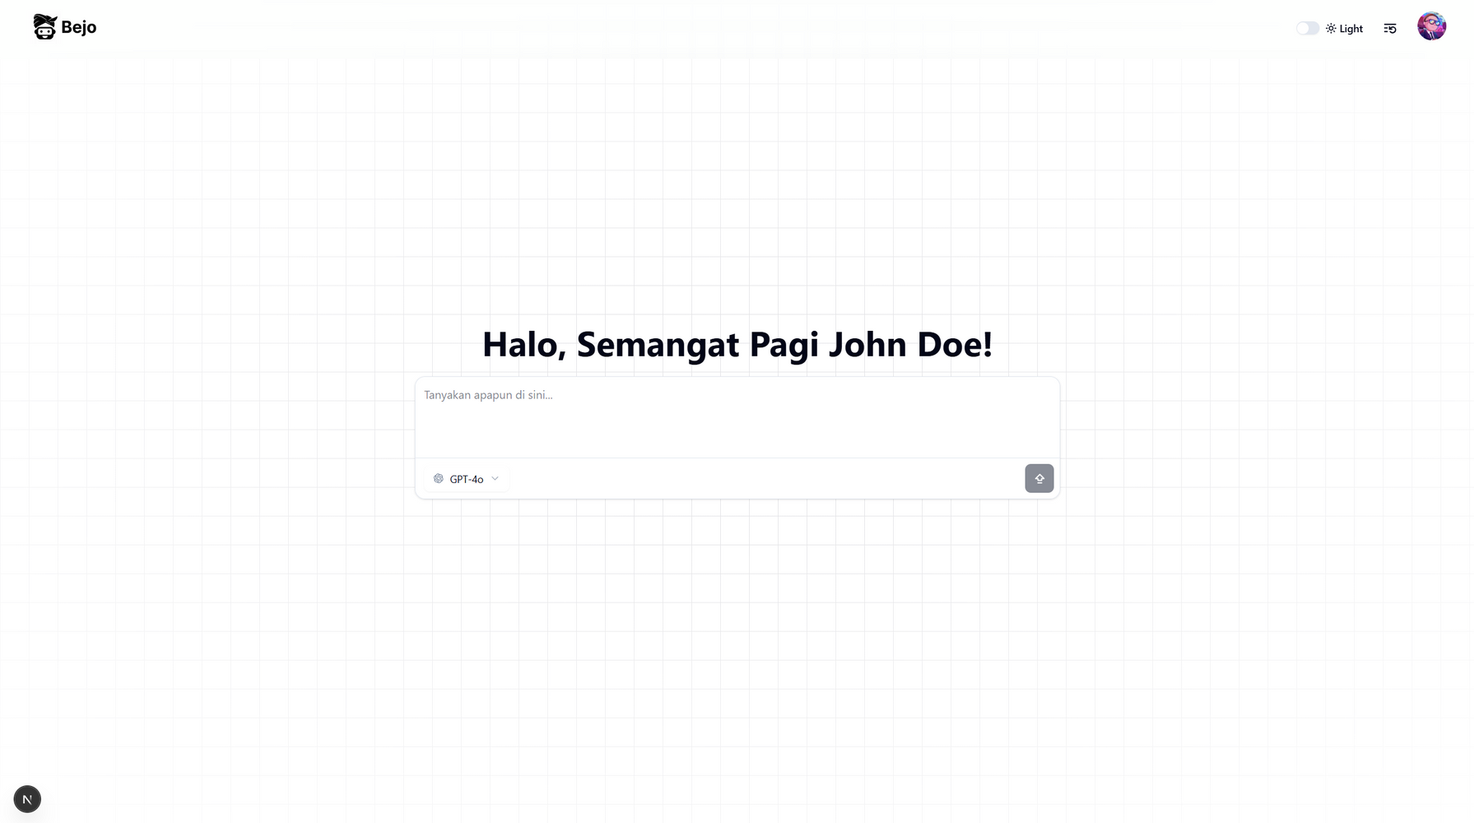

Slide 8
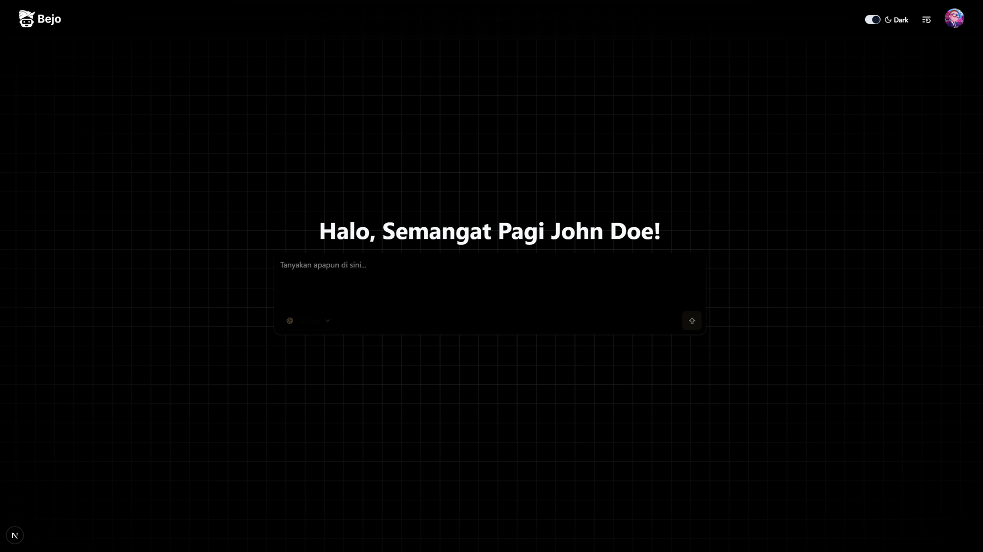

Slide 9
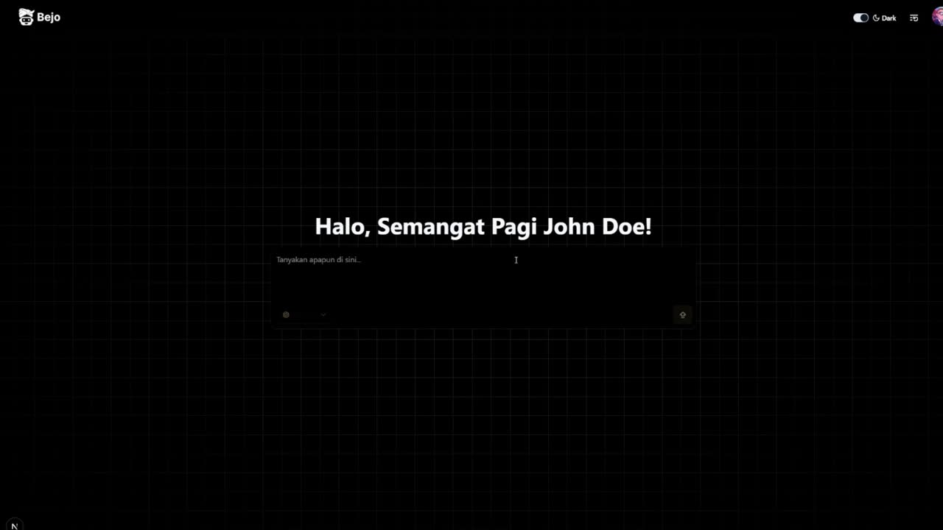
DEMO Project BEJO
BEJO IS
HERE

Slide 10





The Models
DEPLOYMENT
Gemini for Development: Chosen due to its generous free tier offering up to 2 million tokens, making it ideal for experimentation and prototyping.
ChatGPT for Deployment: Preferred for its high scalability and robust infrastructure, ensuring reliable performance in handling large volumes of user requests.
Claude 3.7 Sonnet for superior reasoning and coding accuracy, especially in complex tasks.
Ollama for Consideration: Being open-source, it provides transparency and insight into the underlying processes, making it a valuable option for understanding and customizing the model behavior.
DEVELOPMENT
OPTION 1
OPTION 2
OPTION 3

Slide 11
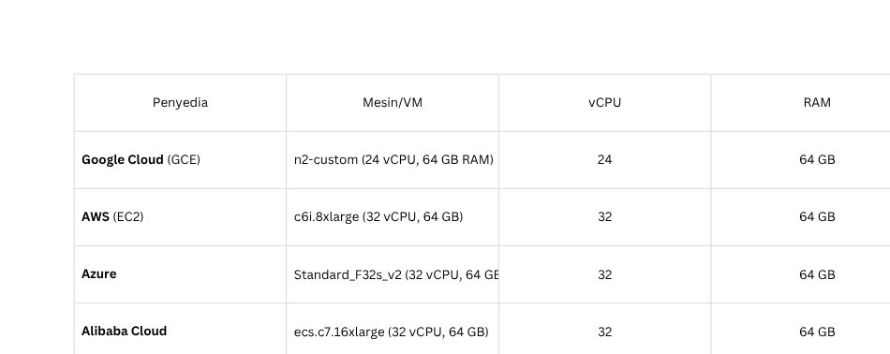
ESTIMATING BEJO’S COST
First Choice (Self-Hosted)

Slide 12
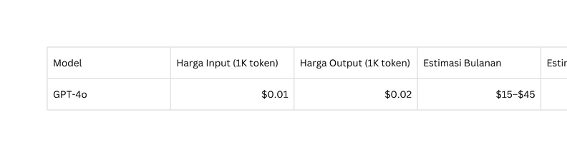
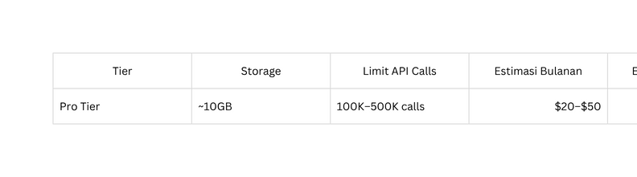
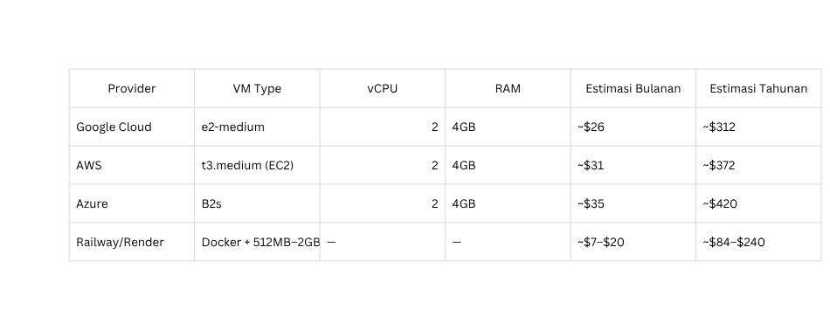
ESTIMATING BEJO’S COST
Second Choice (SaaS)
gpt-4o
mem0
containerization

Slide 13
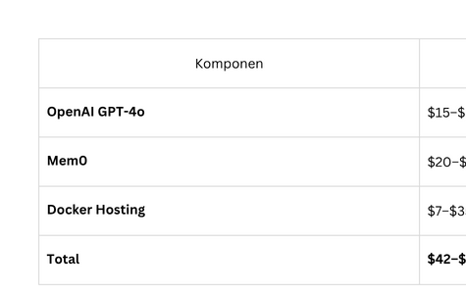
ESTIMATING BEJO’S COST
SECOND CHOICE

Slide 14
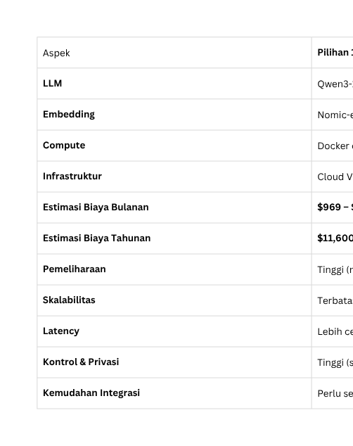
ESTIMATING BEJO’S COST
SUMMARY

Slide 15

TESTING SCHEMA
RESPONSE
SAME QUESTION
.
.
.
.
OBJECTIVE
The response must be same for
N user (precision)
Loop for M times. to measure the concistensy

Slide 16
The End
THANK YOU FOR LISTENING
REFERENCES:
https://humanloop.com/blog/mcp
https://docs.crewai.com/introduction
https://www.descope.com/learn/post/mcp
https://python.langchain.com/docs/introduction/

